Slide 1

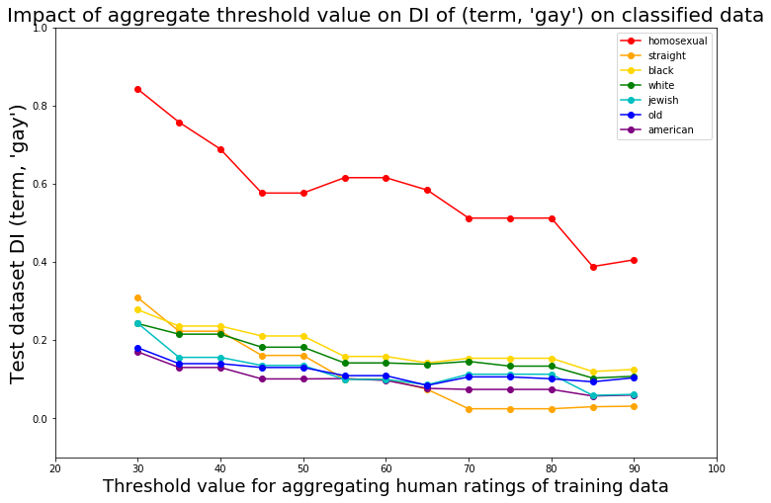
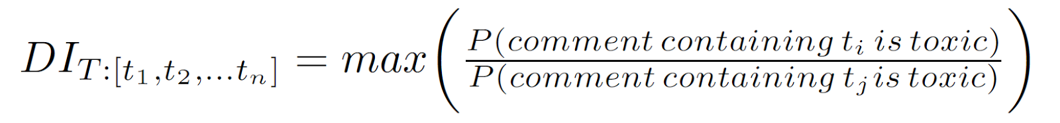
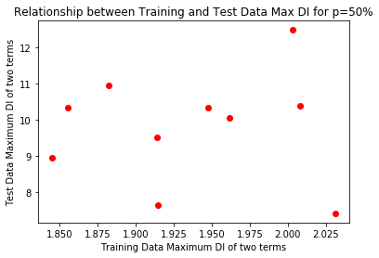
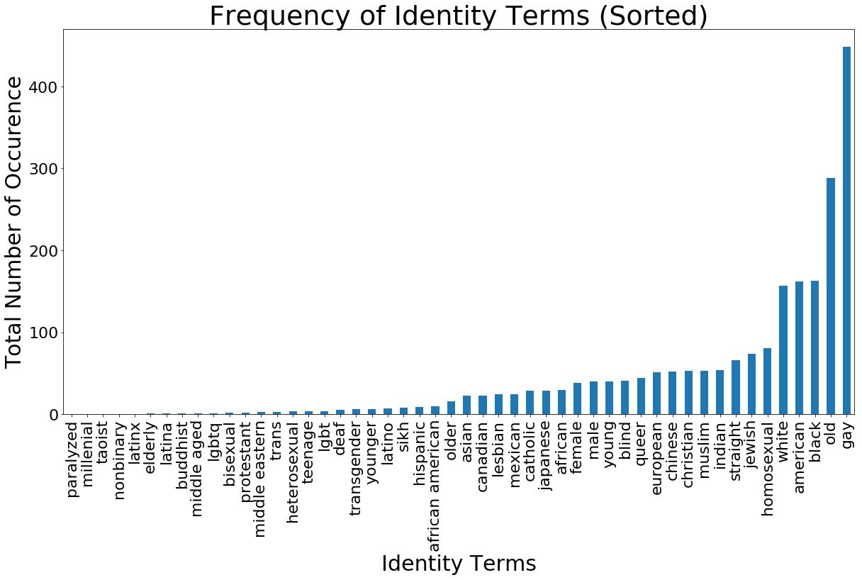
Analysis of toxic comment classification in perturbed text datasets
Neha Gupta, Yujing Ke, Neil Pruthi, Brandon Fain, Ashwin Machanavajjhala
Motivation
Leaving comments online is easy, but ensuring user comments are appropriate can be difficult. Negative online behavior can drive away and upset users. Websites may want to deploy a classifier to automatically flag comments that are mean, hateful, prejudiced, offense, or some combination thereof.
However, a classifier may exhibit bias and lead to unfairness because it may predict, correctly or incorrectly, a toxic label for comments about a particular demographic group more often than comments about other demographic groups. This can stem from biased input data, because whether or not a comment is toxic may be subjective. We are interested in how different levels of dataset bias affect the bias of a classifier trained on that dataset for text classification, a context in which crowdsourced data makes it difficult to discern ground truth.
Method (continued)
Perturbing our training data
To introduce noise into our training data, we randomly select comments with some probability p, and for those comments, we assign a random toxicity value of either 0 or 1, with 0 indicating a comment is toxic.
Our measure of bias in data is disparate impact, generalized from its typical two-class definition, as we have more than two demographic identity groups. Intuitively, a high value of disparate impact means that comments containing an identity term t₁ are more likely to be labeled as toxic than comments containing an identity term t₂. We compute the pairwise disparate impact for each pair of terms and then take the max:
The figure below shows disparate impact of both our training and test data.
Altering the threshold above which the average of human toxicity ratings must be for a comment to be labeled as toxic
Our original dataset of crowdsourced comment toxicity ratings has around ten human raters for each comment [2]. [1] labels a comment as toxic if the mean of its toxicity ratings is greater than or equal to 0.5. We adjust this threshold and observe changes in disparate impact.
Intuitively, a low threshold errs on the side of caution, and labels something as toxic if even only a few human raters label it as toxic. Thus, more comments in our dataset are labeled as toxic.
We compare each demographic identity term to the term ‘gay’, as shown in the following figure. We choose to use the term ‘gay’ as it occurs most frequently, and is used as a metric in [1].
For the majority of terms, as threshold increases, DI ([term], ’gay’) decreased for both the training and test data. In the next figure, we display the test dataset’s DI for each term at each threshold, to show how much change there is in the bias of a pair of terms before and after training a classifier.
Method
We use a dataset of ~100,000 Wikipedia Talk Page comments that have been rated by humans as either toxic or non-toxic.
Our data is split into a training dataset of ~96,000 comments and a test dataset of ~33,000 comments. We used a logistic regression classifier to predict whether a comment is toxic or non-toxic.
In order to ensure we have sufficient sample sizes for each identity term, we only show results for demographic identity terms that appear in at least 3% of comments containing identity terms. The figure below shows the identity terms, in set T, that met this criterion.
Results
These data illustrate how text classifiers introduce biases between demographic groups, even when training data has randomly minimized bias, and that this bias can be either exacerbated or minimized when varying the mean human toxicity rating threshold.
The graph showing the relationship between training and test DI shows that regardless of how much noise we introduced in the data, the disparate impact of the test data was unaffected by our range of training data disparate impact values. The bias of predicted values seems unaffected by random noise introduced in training data.
The results of the threshold graph show that when we are less cautious in labeling comments as toxic, by requiring a higher threshold of mean toxicity, the probability that terms are predicted to be similarly toxic to ‘gay’ tends to decrease.
Further Work
We hope to try additional fairness metrics such as Equality of Opportunity and Predictive Parity.
We also hope to look into the relationship between the demographics of human raters and disparate impact of a text comment dataset.
[ Rudinger, Rachel, Chandler May, and Benjamin Van Durme. "Social bias in elicited natural language inferences." Proceedings of the First ACL Workshop on Ethics in Natural Language Processing. 2017.
Bolukbasi, Tolga, et al. "Man is to computer programmer as woman is to homemaker? debiasing word embeddings." Advances in Neural Information Processing Systems. 2016.
Hardt, Moritz, Eric Price, and Nati Srebro. "Equality of opportunity in supervised learning." Advances in neural information processing systems. 2016.
Kusner, Matt J et al. “Counterfactual Fairness.” available at http://papers.nips.cc/paper/6995-counterfactual-fairness.pdf (accessed 26 Nov 2018). 2018]
References
Dixon, Lucas, et al. "Measuring and mitigating unintended bias in text classification." available at: www.aies-conference. com/wp-content/papers/main/AIES_2018_paper_9. pdf 2018.
Wulczyn, Ellery, Nithum Thain, and Lucas Dixon. "Ex machina: Personal attacks seen at scale." Proceedings of the 26th International Conference on World Wide Web. International World Wide Web Conferences Steering Committee, 2017.
Department of Computer Science Duke University
cs.duke.edu
Mauris orci mi, varius id diam id, egestas auctor enim.

